Slide 1
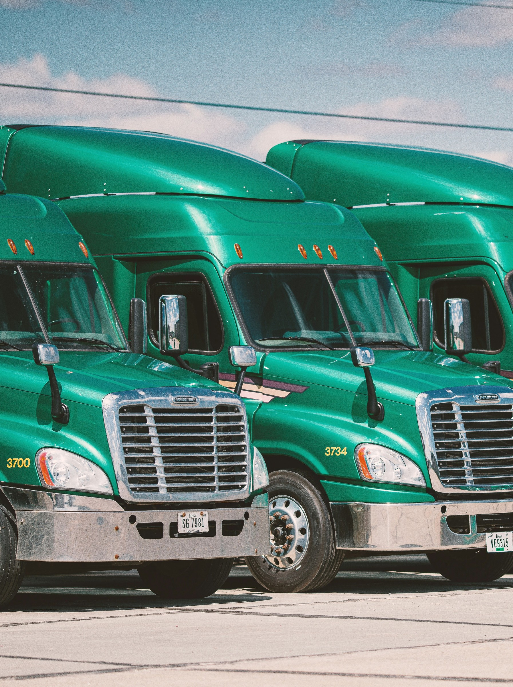

SEPTEMBER 2026
Annual & Special
Meeting of Shareholders

Slide 2
Disclaimer
This presentation contains historical and forward-looking statements. The forward-looking statements involve risks and uncertainties. Forward looking statements appearing in this presentation represent management's current estimates and these may change significantly as new information comes to hand.
The information contained in this presentation has been obtained by AirIQ Inc. from its own records and from other sources believed to be reliable, however no representation or warranty is made as to its accuracy or completeness. Reference should be made to the Company's most recent Annual Report filed with Canadian securities regulatory authorities (and available at www.sedarplus.ca) for a description of the major risk factors.

Slide 3
ANNUAL REPORT
Highlights of Fiscal Year March 31, 2026
RECURRING REVENUE
TOTAL REVENUE
GROSS PROFIT
GROSS MARGIN
+23%
+17%
+14%
60%
Increased to $5.9 million
Increased to $6.5 million
Increased to $3.9 million
On $6.5 million of total revenue
CONSISTENT GROWTH
CONSISTENT PROFIT
SHARE REPURCHASE
ACQUISITION
9 Years
10+ Years
561,500
Oct 2025
Of consecutive recurring revenue growth
Of positive operating profit
Shares repurchased for cancellation at $0.33 per share
Expanded the video telematics portfolio and recurring revenue
Fiscal 2026 results for the year ended March 31, 2026. All amounts in CAD.

Slide 4
CAPITAL STRUCTURE
Market Capitalization
Symbol (TSXV)
IQ
Closing Share Price September 21, 2026
$0.45
Warrants as of June 30, 2026
NIL
Shares Issued and Outstanding as of June 30, 2026
29.5 Million
Fully Diluted Shares O/S as of June 30, 2026
30.3 Million
Options as of June 30, 2026
1.8 Million
Market Capitalization as of September 21, 2026
$13.3 Million
Cash as of June 30, 2026
$1.5 Million
Working Capital as of June 30, 2026
$1.8 Million

Slide 5
ANNUAL REPORT
Recurring Revenue
Recurring revenue has risen every year since fiscal 2017, and fiscal 2026 delivered the largest single-year gain.
202%
13%
TOTAL GROWTH IN RECURRING REVENUE
COMPOUND ANNUAL GROWTH
Fiscal years ended March 31, in CAD millions. Total growth measured from fiscal 2017 to fiscal 2026.

Slide 6
ANNUAL REPORT
Revenue Mix
Recurring revenue is now 91% of total revenue, up from 80% four years ago.
91%
+$1.1M
OF FISCAL 2026 REVENUE IS RECURRING
RECURRING REVENUE ADDED IN FISCAL 2026
Fiscal years ended March 31, in CAD millions. Recurring share of total revenue: 80% in fiscal 2022, 87% in fiscal 2025, 91% in fiscal 2026.

Slide 7
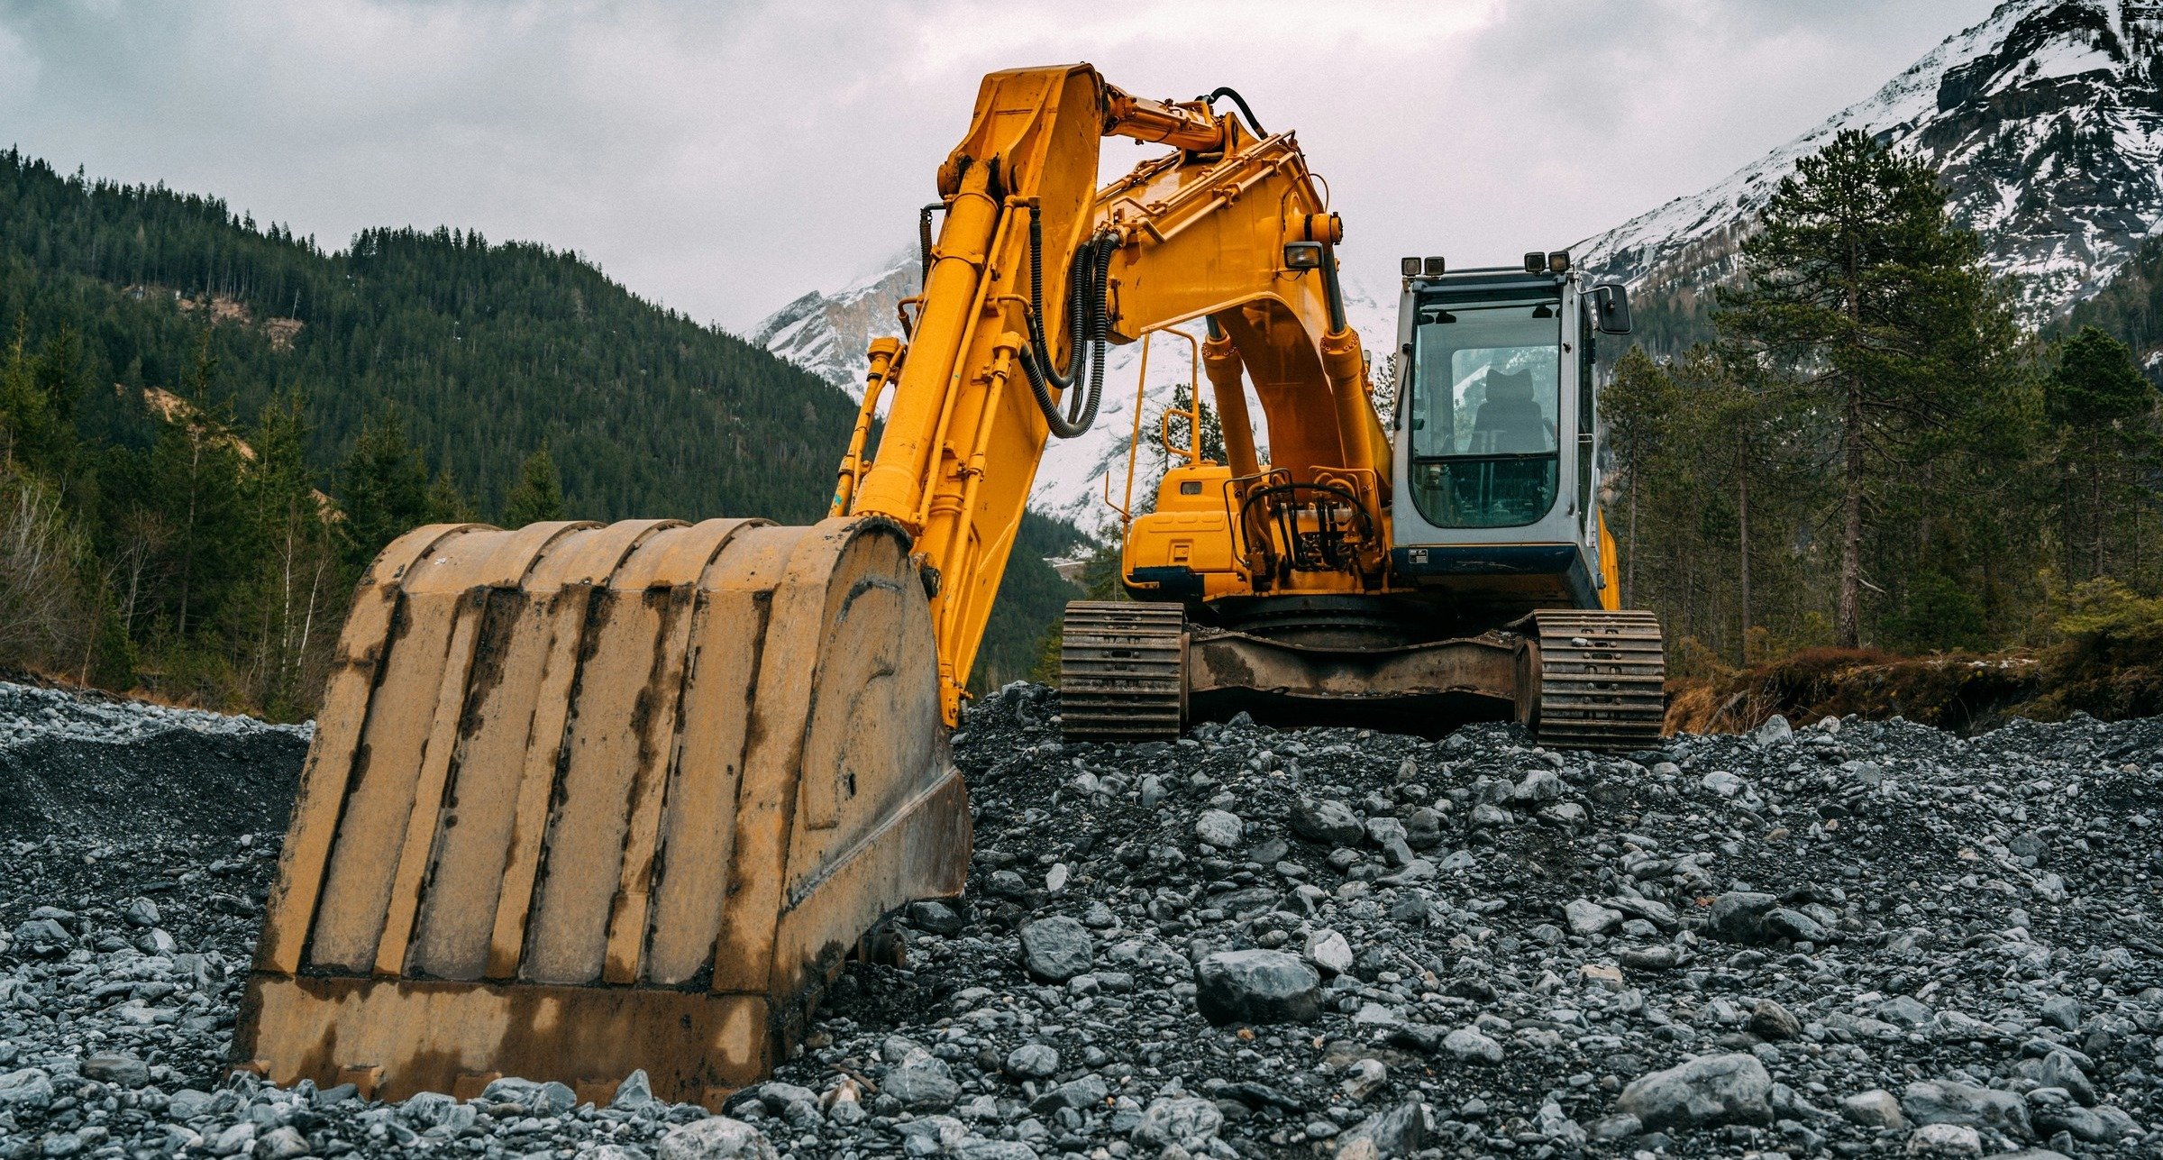
WHO WE ARE
About AirIQ
Proudly Canadian and approaching 30 years in business, AirIQ has maintained a long-standing presence in the growing fleet and asset management space.
Over that history, AirIQ has expanded and strengthened its position as a trusted partner in the IoT industry, leveraging industry partnerships, growing into new markets, and continually improving its IoT solutions.

Slide 8
THE PLATFORM SOLUTIONS
From Device to Decision
Hardware in the field reports in. What comes back is location, exceptions, coaching and evidence.
DATA ACQUISITION
THE PLATFORM SOLUTIONS
INSIGHT DELIVERY
Vehicles
Fleet dashboard
Location, hours of service and engine data
AirIQ Platform Solutions
Where every device reports
Where everything is and what needs attention
Trailers and assets
Driver coaching
Cargo and door status, temperature, battery tags
Safety scoring and video review of real events
Live location and status
Alerts and exceptions
Cameras and crew
Reports and recovery
Road, cab and rear video, emergency response
History and reporting
Hours of service, maintenance, stolen assets
The three market views that follow show what this looks like in each segment.

Slide 9
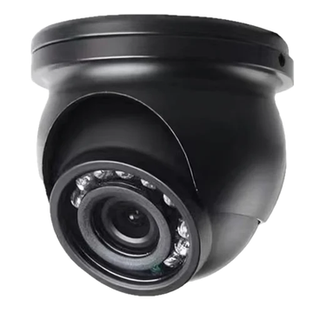
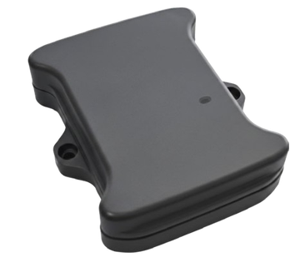
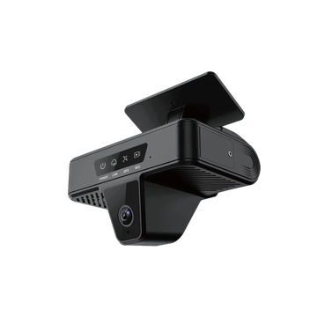
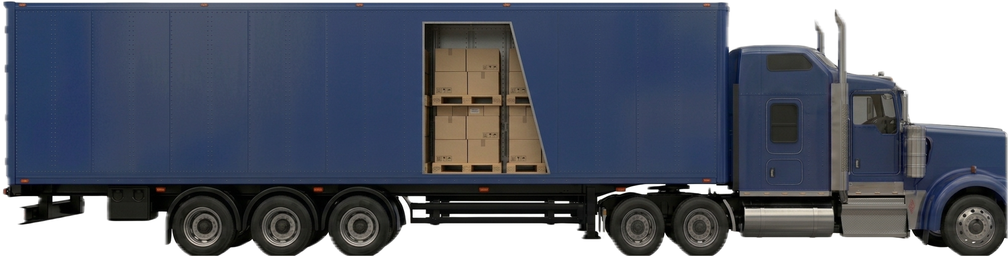
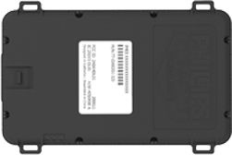
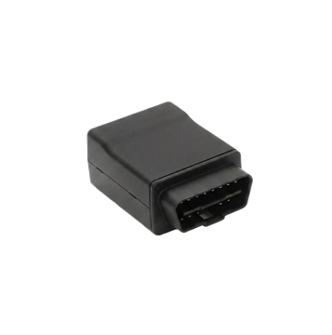
MARKET SOLUTIONS · 1 OF 3
OTR Transportation
Tractor, trailer and load on one platform, with each solution shown where it installs.
Cargo camera
Temperature
Cargo tracking
Video safety
Load and door status
Cargo and reefer
Battery tags on the load
Road and cab cameras
Wheel and brakes
Tire monitoring
Trailer status
GPS and ELD
Wear and rollover alerts
Pressure and auto-inflation
Lights, doors and sensors
Location and hours

Slide 10
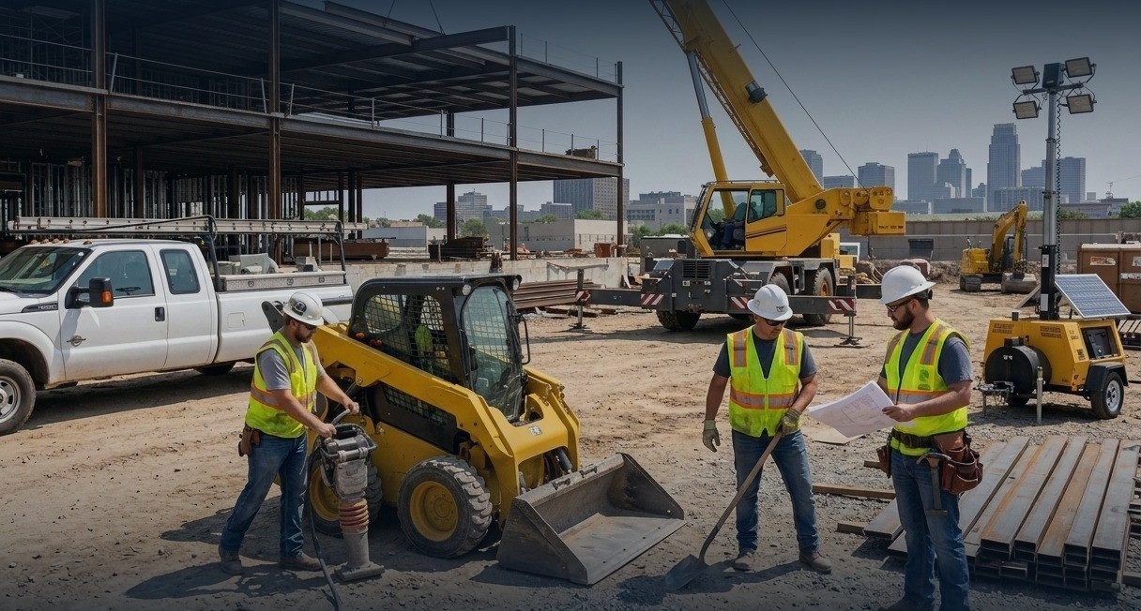
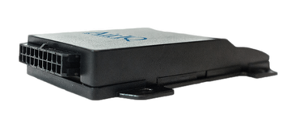
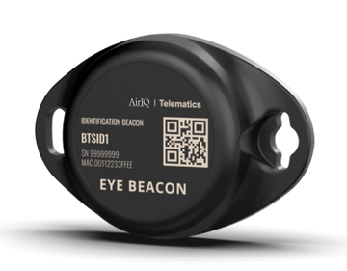
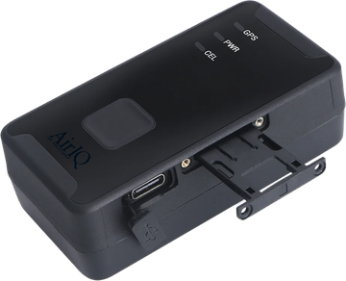
Equipment in use
Battery tracker
MARKET SOLUTIONS · 2 OF 3
Construction
Working hours, not idle hours
Generators, light towers, bins
Heavy equipment, generators, tools and crews, each tracked by the solution that suits it.
Video safety
Machine telematics
Tool tracking
Worker safety
Road, cab and rear cameras
Location, hours and lockout
High-value attachments
Personal emergency response

Slide 11
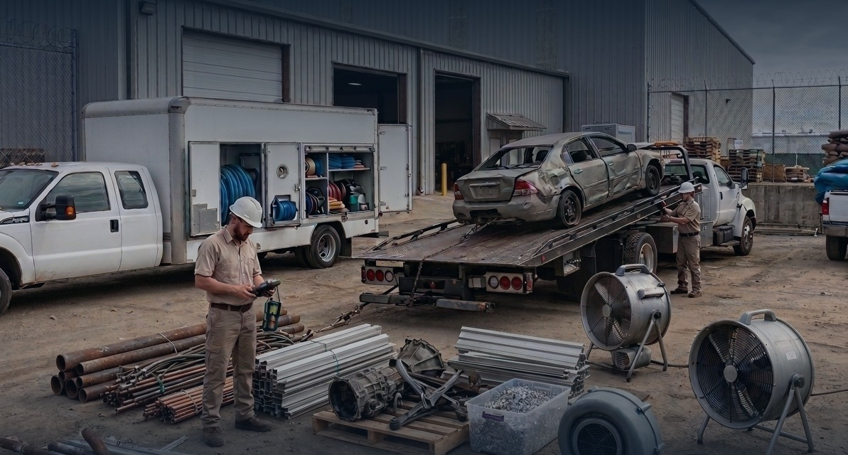
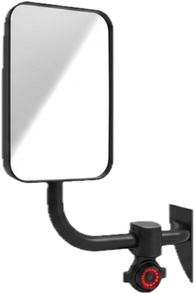
Cargo camera
Door status
MARKET SOLUTIONS · 3 OF 3
Service Fleets
Load area and stock
Every compartment door
Restoration, towing and service crews: the vehicles, what they carry, and the equipment on site.
Vehicle cameras
Worker safety
Rear camera
Asset trackers
Road, cab and blind spot
Personal emergency response
Reversing and winch work
Battery tags on equipment

Slide 12
ACQUISITION
Expanding Video Solutions
In October 2025 AirIQ completed a transaction that expanded its video telematics portfolio beyond the windshield.
Two channels to four
Every blind spot
Black box recording
Four-channel systems today, with six-channel planned.
Side mirror and rear cameras, plus in-vehicle domes for commercial and public transport.
Locked, vibration-resistant drives holding weeks of tamper-proof recording.

Slide 13
UNIT ECONOMICS
Rental Program Economics
AirIQ's Rental Program delivers a lifetime value to customer acquisition cost ratio of 3:1.
$4,000
x3
$13,000
3:1
ACQUISITION COST
RETURN MULTIPLE
LIFETIME VALUE
LTV / CAC
Delivers efficient, sustainable, higher returns to shareholders
Creates predictable and growing streams of recurring revenues
LTV/CAC is lifetime value divided by customer acquisition cost, the return on each dollar spent to win a customer.

Slide 14
PEER VALUATION
Telematics Comparison
AirIQ trades at 2x recurring revenue against an 8x peer average: significantly undervalued relative to its telematics peers.
AirIQ Inc.
(IQ.V)
Total Telcom
(TTZ.V)
BeWhere
(BEW.V)
Blackline Safety*
(BLN)
Samsara
(IOT)
Industry Average
(4 peers)
Enterprise Value
13,310
64,840
14,306
830,249
22,133,146
5,760,386
Recurring Revenue
2,694
9,294
6,246
100,908
1,730,595
460,873
EBITDAS
905
3,095
989
(7,101)
(12,126)
(3,807)
Net Income
565
2,081
157
(15,485)
55,993
10,789
EV / Recurring Revenue
5
7
2
8
13
8
EV / EBITDA
15
21
14
N/A
N/A
18
Share prices as at September 2, 2026. Trailing twelve month financials as of August 2026. CAD thousands except Samsara, reported in USD. Compiled from public filings on SEDAR+ and SEC EDGAR. Industry average is the mean of the four peers, excluding AirIQ; the EV/EBITDA average uses only the peers with positive EBITDA. Recurring revenue here is trailing twelve months, so AirIQ shows 6,246 rather than the 5,916 reported for fiscal 2026.
* Blackline Safety based on transaction price which occurred on June 30, 2026.

Slide 15
INVESTMENT CASE
Why Choose AirIQ
AirIQ delivers a variety of fleet management solutions, providing location tracking, trailer monitoring, driver behaviour insights, and advanced reporting tools. Our scalable, cloud-based platform helps diverse industries improve efficiency, safety, and profits.
Significantly undervalued
High ROI solution offerings
Forging value-driven product solutions
Investment Thesis
No Debt
Delivering shareholder value through recurring revenue, expanding verticals, and technology-driven growth.
Strategic cash reserve for future investments.
Powering progress in key growth markets
Scalable Solutions
Publicly Traded
Strong ARR momentum and customer traction
Transform data into insights that drive results.
Listed on TSXV under ticker IQ.

Slide 16
Contact & Information
Michael Robb President and Chief Executive Officer
investors@airiq.com · www.airiq.com · 888-606-6444

